Slide 1
Political Determinants of Intergovernmental Transfers: A Russian Case study
Mike Smeltzer
4/1/16

Slide 2
Outline
Question
Previous research
Data and methodology
Results and Interpretation
Areas for further research

Slide 3
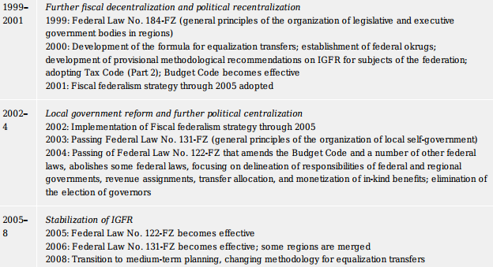
Question
Russia’s Patronal Political Regime
Informal Politics
+
Fiscal Federalism
Formal politics
=
???
Alexeev, Michael, and Shlomo Weber, eds. The Oxford Handbook of the Russian Economy. 1st ed. Oxford University Press, 2013. Table 27. Sourced from: Table 3.1 De Silva et al. (2009)
What are the effects of informal politics on formal politics in Russia?
Patronalism -> Fiscal Allocations
Notes:
Russia’s Patronal Political Regime = established and maintained through networks of personal connections
Fiscal Federalism = “objective”, based on legislated methodology for determining allocations

Slide 4
Previous Research On Fiscal Federalism in russia
D. Treisman – 1996, 1998
V. Popov – 2004
U. Thiessen - 2006
E. Jarocinska - 2010
M. Alexeev & S. Weber – 2013
90s – Appeasement or Reward?
Early 00s – Putin’s visits to the regions
What about after 2011-2012 protests?
  Previous determinants still relevant?
  What else is playing a role?

Slide 5
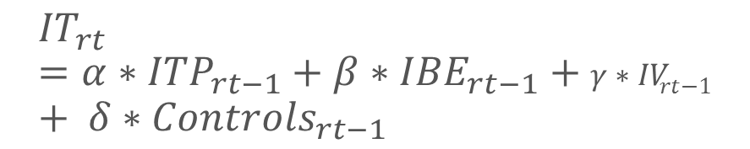
Data and methodology
Intergovernmental Transfers (Russian Treasury)
Tax and Budget Indices (Ministry of Finance)
Regional Election Data (Central Election Commission)
Regional Socio-Economic Data (Goskomstat)
Regional Protests (Lankina, 2015)
OLS Linear Regression Model
$${IT}_{rt}=α∗{ITP}_{rt−1}+β∗{IBE}_{rt−1}+γ∗{IV}_{rt−1}+ δ∗{Controls}_{rt−1}$$
Robustness Checks:
Unified Regression
Interaction Terms
Cook’s Distance/Leverage

Slide 6
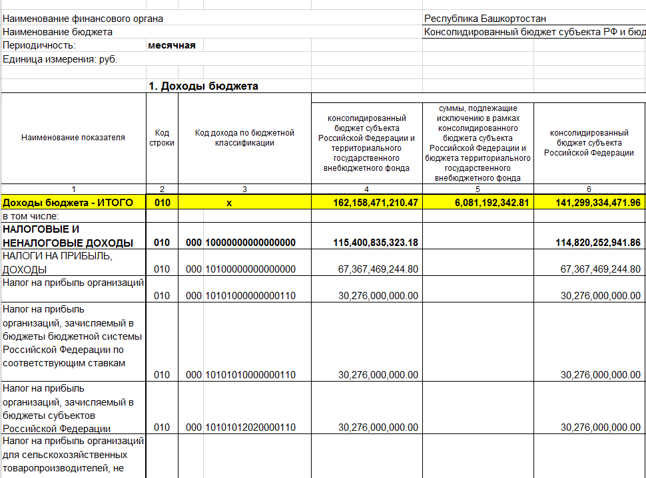
Variable | mean | min | max | sd | N
Putinmeet | 0.1 | 0 | 1 | 0.301893 | 80
Putinvisit | 0.2625 | 0 | 1 | 0.442769 | 80
Putineither | 0.3625 | 0 | 1 | 0.483755 | 80
ITP | 0.84989 | 0.119 | 7.42 | 0.96221 | 80
IBE | 1.24771 | 0.495 | 7.122 | 1.042127 | 80
GRP2012 | 623999 | 29616 | 1E+07 | 1302701 | 80
GRPgrowth | 0.03376 | -0.069 | 0.153 | 0.036544 | 80
GRPpc | 291169 | 78934.2 | 1E+06 | 219617.3 | 80
forputin | 556305 | 21310 | 2E+06 | 476499.2 | 80
pctputin | 0.64239 | 0.4695 | 0.9976 | 0.101978 | 80
foropp | 153473 | 182 | 868736 | 144745.1 | 80
pctopp | 0.17415 | 0.0003 | 0.2909 | 0.052328 | 80
marginvic | 0.46824 | 0.2375 | 0.9973 | 0.149478 | 80
pctpopputin | 0.32447 | 0.16647 | 0.6183 | 0.073553 | 80
poverty | 13.3625 | 6.5 | 30.7 | 4.240384 | 80
pop | 1791838 | 51000 | 1E+07 | 1761628 | 80
govtemp | 19048.5 | 2677 | 72339 | 12829.75 | 80
pctgov | 0.01347 | 0.00604 | 0.0525 | 0.006312 | 80
TotalInc2012 | 9.6E+10 | 8.9E+09 | 2E+12 | 1.78E+11 | 80
TotalInc2013 | 1.1E+11 | 1.1E+10 | 2E+12 | 1.84E+11 | 80
GovTrn2012 | 2.2E+10 | 4.4E+09 | 9E+10 | 1.6E+10 | 80
GovTrn2013 | 2.9E+10 | 5.8E+09 | 2E+11 | 2.36E+10 | 80
pctdpngov2012 | 0.35022 | 0.05631 | 0.8786 | 0.177614 | 80
pctdpngov2013 | 0.38159 | 0.09768 | 0.8672 | 0.169364 | 80
chggovtrn | 6.8E+09 | -8E+09 | 7E+10 | 1.11E+10 | 80
pctchgtrn | 0.01301 | 0.00815 | 0.0251 | 0.002686 | 80
chgpctdep | 0.01152 | 0.00802 | 0.0204 | 0.002224 | 80
Protest 11 | 8.7125 | 0 | 257 | 29.36121 | 80
Protest 12 | 6.8875 | 0 | 185 | 21.58644 | 80
TotProtest | 15.6 | 0 | 442 | 50.78587 | 80
pctcity12 | 0.6935 | 0.289 | 1 | 0.13201 | 80
pctrur12 | 0.3065 | 0 | 0.711 | 0.13201 | 80
Summary of Data Statistics
Warning: Wading through 100s of Russian finance documents may cause drowsiness.

Slide 7
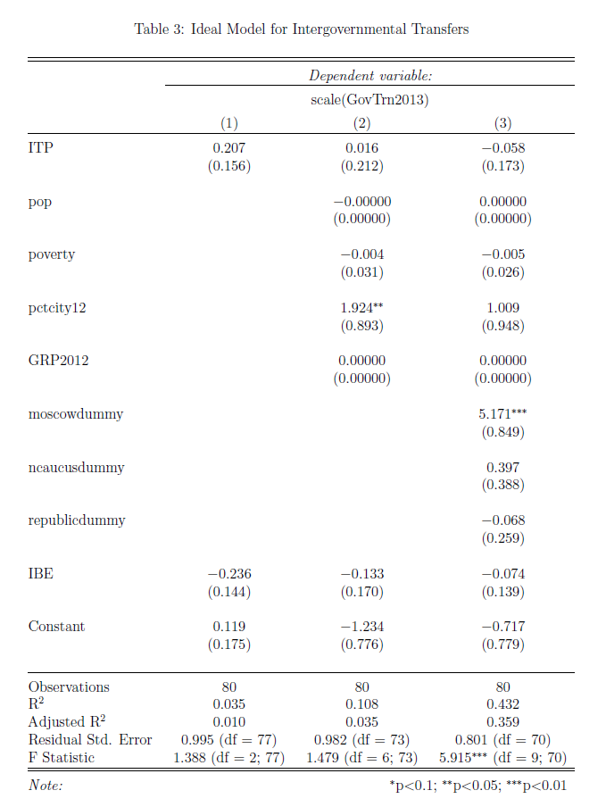
Results
Previous Significant Factors
Legislated Intergovernmental Transfer Methodology
IBE + ITP = IT?
Regional election results?
  Margin of Victory – No
  % Regional Population Vote for Putin – No
  % Regional Electorate – No
Putin’s Visits to the Regions? – No
  Regional Leaders’ visits to meet with Putin in Moscow? – No
  Both visits combined? - No

Slide 8
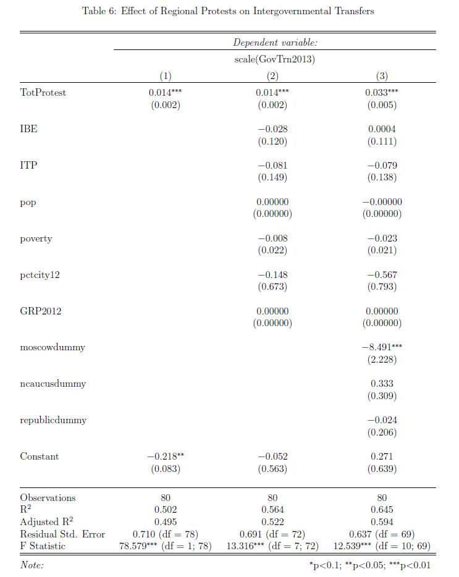
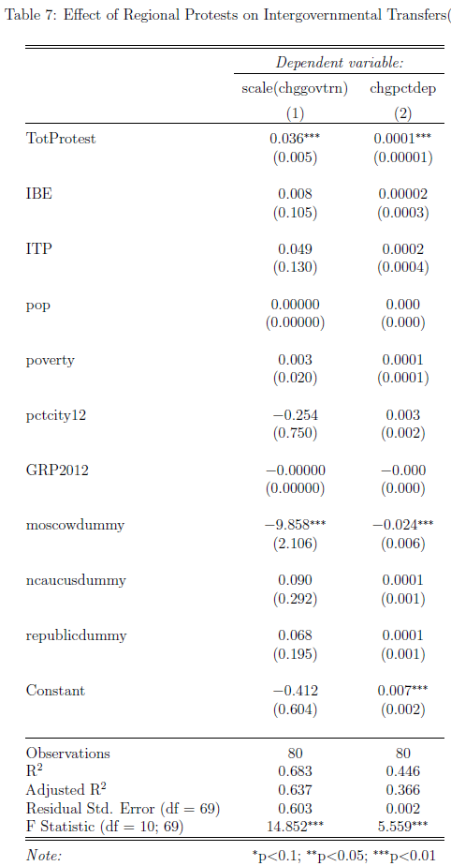
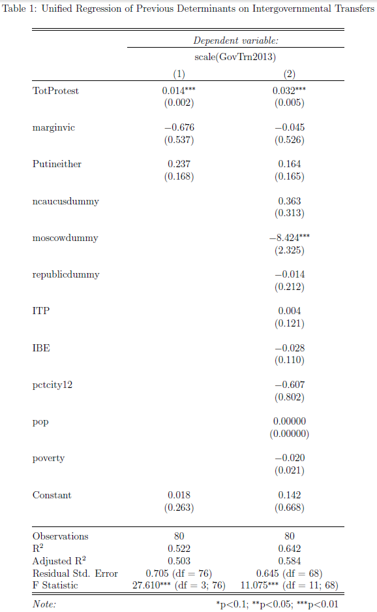
Results and Interpretation
R 780,000,000
$11,500,000

Slide 9
The rest of the story
Dynamics of particular political determinants of intergovernmental transfers as explained by the development, establishment, and maintenance of the patronal regime
What’s left? – Further Research
Panel Data Analysis – 1996-2015
Effect of direct election of governors versus system of appointment?
Role of plenipoteniary envoys?
Effect of current economic crisis?

Slide 10

Thank you!

